Slide 1
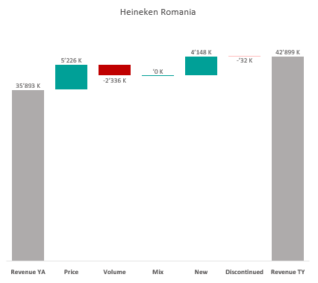

Revenue by Price vs. Volume vs. Mix analysis (Replace with So What)
Revenue by Price vs. Volume vs. Mix analysis | Heineken Romania vs. Asahi | Category | National | P12M
DATA SOURCE: Trade Panel/Retailer Data | Ending Apr 2024

